Slide 1
ADIDAS DATA ANALYSIS By Shamsheera A T
Bussiness Requirements
Through This Powe Bi Analysis ,will understand the business growth and challenges
Understanding of Sales and performance
Identification of Geographical areas with high and low sales
Overall Performance of Business.

Slide 2
Problem Statements:
1.Total Sales Analysis:
Understands the overall Sales Performance of Adidas
2Profitability Analysis:
Evaluate the Total Profit Generated across Different Dimensions.
3.Sales Volume Analysis:
Examine the Total Unit Sold to Gain insight into Product Demand
4.Pricing Strategy:
Determine The Average Price Per Unit To access The Pricing Strategy
5.Margin Analysis:
Evaluate the average Margin to understand the overall Profitability of Sales

Slide 3
Analysis done for :
1.Total sales by month(Area Chart):Visualize the Monthly Distribution of total Sales to identify Peak Periods
2. .Total sales by State(Filled Map):Geographically Represent Total Sales Across Different states Using Filled Map
3. .Total sales by Region(Donut Chart):To Represent the Contribution of Different Region To Total Sales
4. .Total sales by Product(Bar Chart):Analyze the Sales Distribution among various Adidas Product Using Bar chart
5. .Total sales by Retailer(Bar Chart): Analyze the Contribution of Different retailers among various Adidas Product Using Bar chart
6.Overall Performance using Cards
7.Slicer for each Region :Using Slices we can see Specific Region

Slide 4
Overall Performance using Cards
Overall How business is performing is analyzed using Cards such as
Total sale
Profit
Unit sold
Average Margin
Average Price per Unit

Slide 5
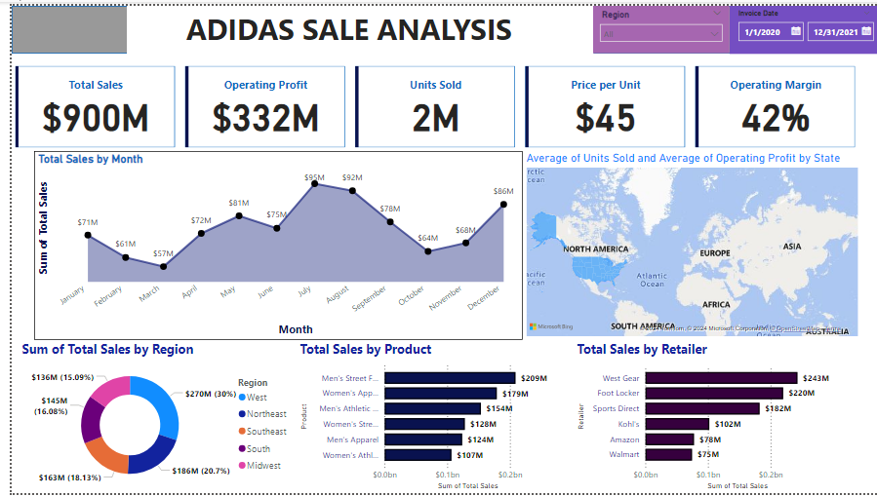
Analysis

